Slide 1
SYNTHETIC AGEING USING CONDITIONAL GENERATIVE ADVERSARIAL NETWORKS WITH IDENTITY PRESERVATION
By,
Rahul Radhakrishnan
Instructor- Dr. Dapeng Oliver Wu
EEL6285: Pattern Recognition and Intelligent Systems
Spring 2020

Slide 2
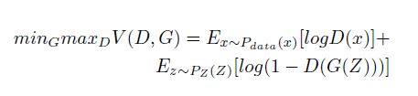
Generative Adversarial Network (GAN)
GAN consist of two models known as Generator (G) and Discriminator (D).
Generator (G) network is a Generative model which reproduces the input distribution.
Discriminator (D) network is a discriminative model which distinguishes the original image and the reproduced image.
The framework of the GAN resembles a min-max 2 player game.
The generator minimizes the objective shown below whereas the discriminator maximizes the objective.

Slide 3
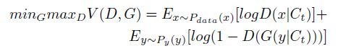
Condition Generative Adversarial Network (CGAN)
A CGAN is an alternate version of the GAN in which the Generator network and Discriminator networks are conditioned over some prior information.
The prior information is incorporated in the reproduced distribution of the input by the generator.
The discriminator distinguishes between the images now with consideration of the prior information provided.
The objective of CGAN is shown below, the generator minimizes the objective whereas the discriminator maximizes it.

Slide 4
SYNTHETIC AGEING
Synthetic Ageing or Age synthesis is the process of transforming a facial image of a person of a particular age to the desired target age.
Traditionally, two commonly used strategies for synthetic Ageing are Prototype-based approach and physical-model based approach.
Physical model-based methodology lies significance with respect to change in the physical highlights of the face, for example, the skin texture and facial muscle.
The Prototype-based procedure contains figuring the normal face during a time run and consolidating it as the maturing design in the integrated picture of target age.
A cGAN with latent vector optimization for identity preservation was proposed in the paper titled ‘Face Aging Using Conditional Generative Adversarial Network’.
The above proposed method failed because it calculates a latent vector for each image and hence requires a huge computational force.

Slide 5
Identity Preserved Conditional Generative Adversarial Network (IPCGAN)
The framework of IPCGAN consists of three modules: CGAN Face generation module, identity preservation module, age classification module.
CGAN is used for face generation to incorporate ageing in the synthesized image. An alternate version of CGAN known as the Conditional Least Square Generative Adversarial Network (CLSGAN) is used because the optimization of the objective of CGAN is unstable and hence will result in poor results.
CLSGAN enforced both the images towards the decision boundary and hence ensure promising results.
To preserve the identity of the individual in the synthesized image a perceptual loss is introduced in the objective.
Feature extracted in a layer of the pretrained network is used for identity preservation.
Perceptual loss encourages the synthesized image to stay close to the features of the input image.
For the Age Classification Module I have used a pretrained model and during the training of IPCGAN a small penalty is given if the synthesized image is correctly classified otherwise a huge penalty is given.

Slide 6
Dataset
The Cross-Age Celebrity Dataset(CACD) is used for this project.
It contains more than 1,60,000 face images of 2000 celebrities from age ranging from 16-60+.
The dataset is divided in 5 age groups depending on what age the face image belongs to: 10-19,20-29,30-39,40-49,50+
The dataset is preprocessed to remove or mask unreliable data and then center cropping and resizing the image to 400x400.
The dataset is then split as 90% training data and 10% test data set.

Slide 7
Evaluation
I will compare my implementation with the implementation of a cycleGAN with latent vector optimization for identity preservation.
For this purpose, I have chosen 5 images, each from 5 different age groups and each of these images are aged to different target age groups using both the models.
The results are presented in the next slide and it can be observed that the latent vector optimized cycleGAN does not show any vivid changes in different age groups and the generated images are blurry and unaesthetic.
Whereas, the results produced using the IPCGAN model can be observed to have the same identity in all age groups and the face ageing pattern in each of the age groups are evident. The age classifier network forces the synthesized face into the target age and hence the face ageing pattern in each of the age groups are evident.

Slide 8
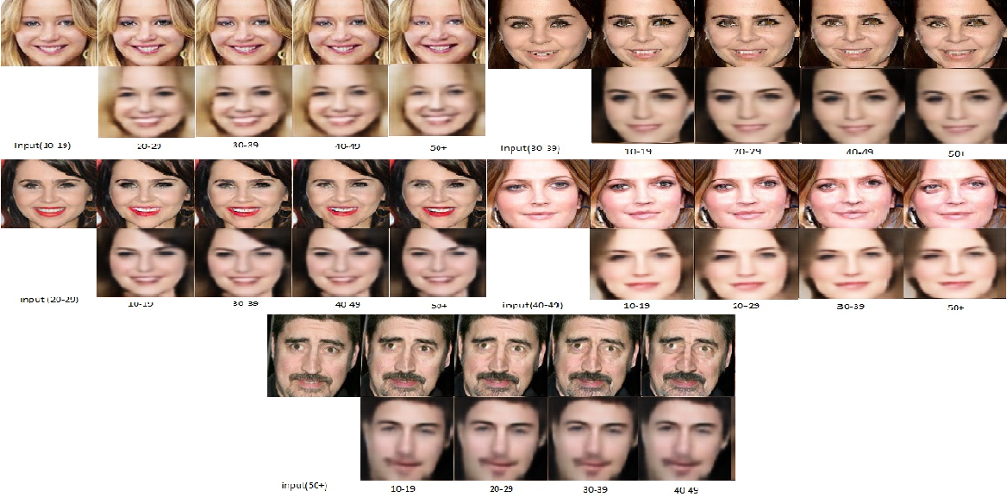
Results

Slide 9
Conclusion
The Generative Adversarial Network (GAN) has shown immense results in image generation.
The identity preservation module in the IPCGAN ensures that the synthesized image should have all the high-level features of the input image and the age classifier network guarantees that the synthesized image is enforced in the correct target age and hence making ageing pattern evident.
This results in the IPCGAN producing promising results for synthetic ageing.

Slide 10
THANK YOU!

